Slide 1


ENGR 1111 Intro to Engineering: Civil Engineering Fall 2022 Part 10: Water Quality and Pollution

Slide 2
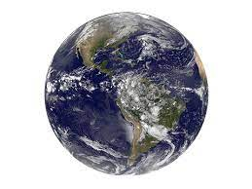
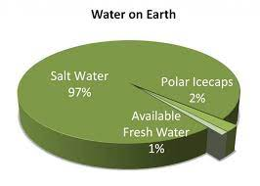
Part 10: Water Quality and Pollution
Only 1% of the Earth’s water is accessible for fresh water uses
Finding high-quality fresh-water sources is increasingly difficult

Slide 3
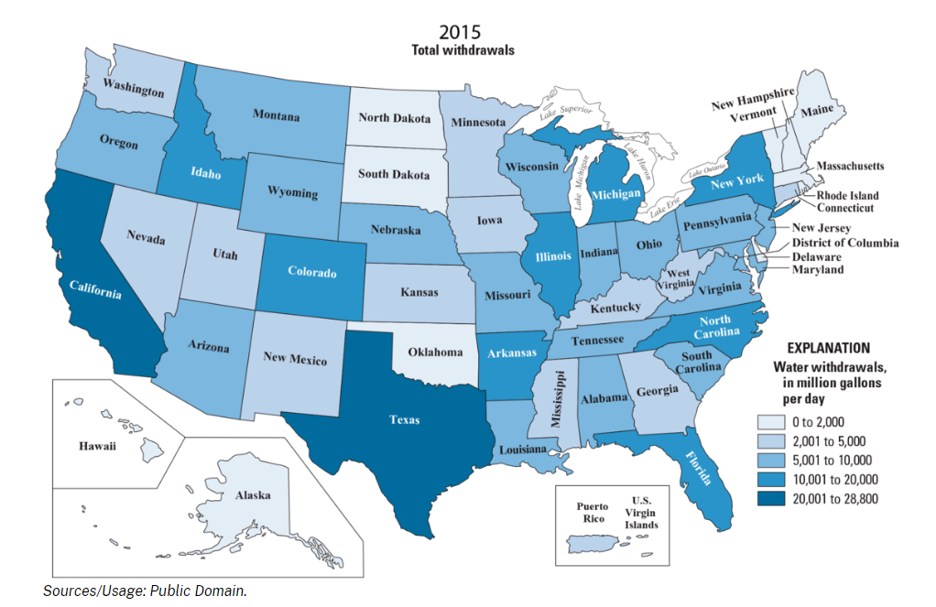
Part 10: Water Quality and Pollution
The US Geological Survey publishes a water-use report every 5 years

Slide 4
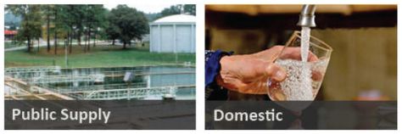
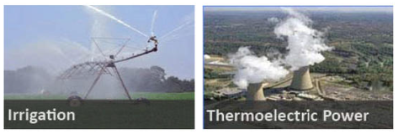
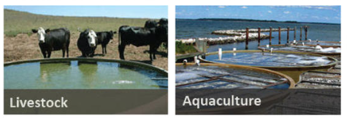
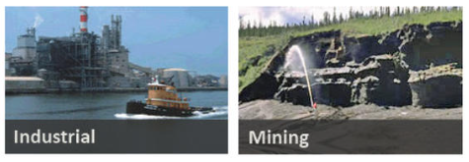
Part 10: Water Quality and Pollution
Categories of Water Usage
Public Supply
Domestic
Irrigation
Thermoelectric Power
Livestock
Aquaculture
Industrial
Mining

Slide 5
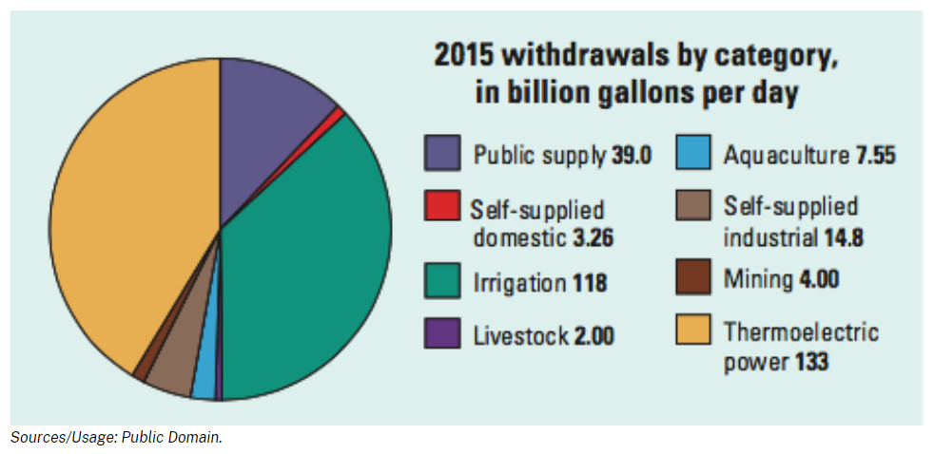
Part 10: Water Quality and Pollution
90% of water usage falls into three categories: thermoelectric power, irrigation, and public supply

Slide 6
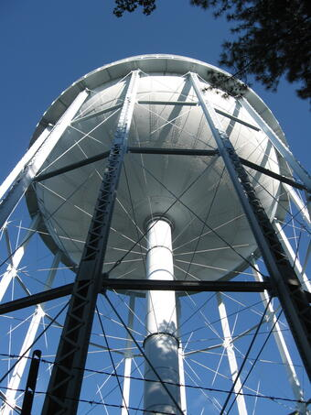
Part 10: Water Quality and Pollution
Public Supply
Water withdrawn by public and private water suppliers that is distributed to at least 25 people or to water systems that have a minimum of 15 connections.
Public supply may also be furnished to commercial, domestic, industrial, and thermoelectric power suppliers.

Slide 7
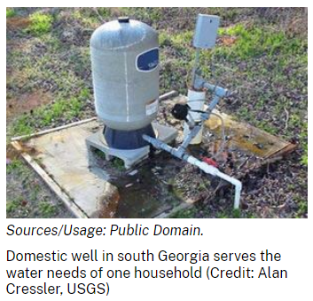
Part 10: Water Quality and Pollution
Domestic
Water used for indoor and outdoor household purposes
Public and self-supplied withdrawals
Indoor: Bathing, Cooking, Drinking, flushing toilets, washing clothes
Outdoor: Watering gardens and lawns

Slide 8
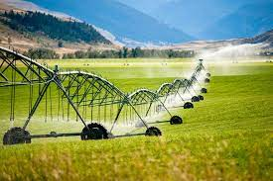
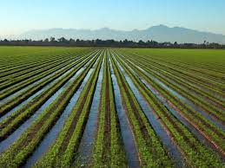
Part 10: Water Quality and Pollution
Irrigation
Provides water for:
Agricultural and horticultural activities
Golf courses
Cemeteries
Turf farms
Preplant irrigation
Frost protection
Dust suppression

Slide 9
Part 10: Water Quality and Pollution
Thermoelectric Power
Water for thermoelectric power is used in the process of generating electricity with steam-driven turbine generators.
Since 2000, thermoelectric-power withdrawals have been compiled by cooling-system type.
Once-through cooling refers to cooling systems in which water is circulated through heat exchangers, and then returned to the source.
Recirculating cooling refers to cooling systems in which water is circulated through heat exchangers, cooled using ponds or towers, and then recirculated.
Subsequent water withdrawals for a recirculating system are used to replace water lost to evaporation, blowdown, drift, and leakage.
Prior to 2000, thermoelectric-power withdrawals were compiled by fuel type (fossil-fuel, nuclear, and geothermal).

Slide 10
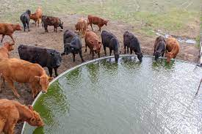
Part 10: Water Quality and Pollution
Livestock
Dairy operations
Feedlots
Livestock watering
On-farm usages
Livestock includes dairy cows and heifers, beef cattle and calves, sheep and lambs, goats, hogs and pigs, horses, and poultry.
Other livestock water uses include cooling of facilities for the animals and products, dairy sanitation and wash down of facilities, animal waste-disposal systems, and incidental water losses.
The livestock category excludes on-farm domestic use, lawn and garden watering, and irrigation water use.

Slide 11
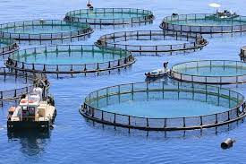
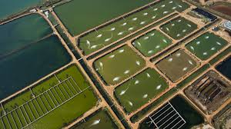
Part 10: Water Quality and Pollution
Aquaculture
Aquaculture water use is water associated with raising organisms that live in water—such as finfish and shellfish—for food, restoration, conservation, or sport.
Aquaculture production occurs under controlled feeding, sanitation, and harvesting procedures primarily in ponds, flowthrough raceways, and, to a lesser extent, cages, net pens, and closed-recirculation tanks.

Slide 12
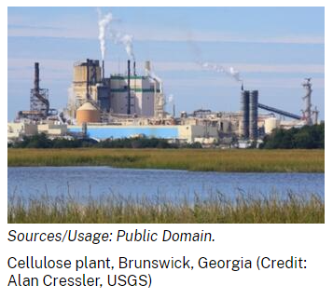
Part 10: Water Quality and Pollution
Industrial
Industrial withdrawals provide water for such purposes as fabricating, processing, washing, diluting, cooling, or transporting a product; incorporating water into a product; or for sanitation needs within the manufacturing facility.
Some industries that use large amounts of water produce such commodities as food, paper, chemicals, refined petroleum, or primary metals.
Water for industrial use may be delivered from a public supplier or be self supplied.

Slide 13
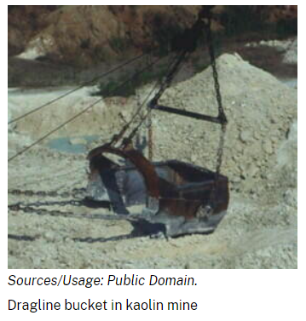
Part 10: Water Quality and Pollution
Mining
Mining water use is water used for the extraction of minerals that may be in the form of solids, such as coal, iron, sand, and gravel; liquids, such as crude petroleum; and gases, such as natural gas.
The category includes quarrying, milling of mined materials, injection of water for secondary oil recovery or for unconventional oil and gas recovery (such as hydraulic fracturing), and other operations associated with mining activities.
Dewatering is not reported as a mining withdrawal unless the water was used beneficially, such as dampening roads for dust control.

Slide 14
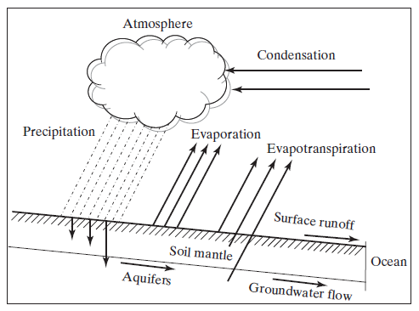
Part 10: Water Quality and Pollution
Hydrologic Cycle

Slide 15
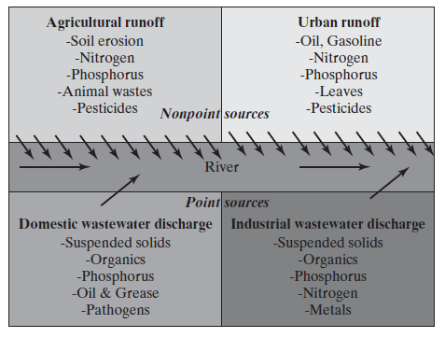
Part 10: Water Quality and Pollution
Water Pollution
Occurs both naturally and by anthropogenic means
Discharge or release of contaminants into water at concentrations that have an adverse effect on human health, well-being, and the environment

Slide 16
Part 10: Water Quality and Pollution
Water Quality Parameters
Physical – affect the senses: sight, taste, smell, and touch
Chemical – relate to the actual composition of the water, divided into organic and inorganic categories
Biological and Microbiological – associated with disease-causing organisms or pathogens related to public health
Radiological – focus on radionuclides that are found in certain waters that have been exposed to readioactivity

Slide 17
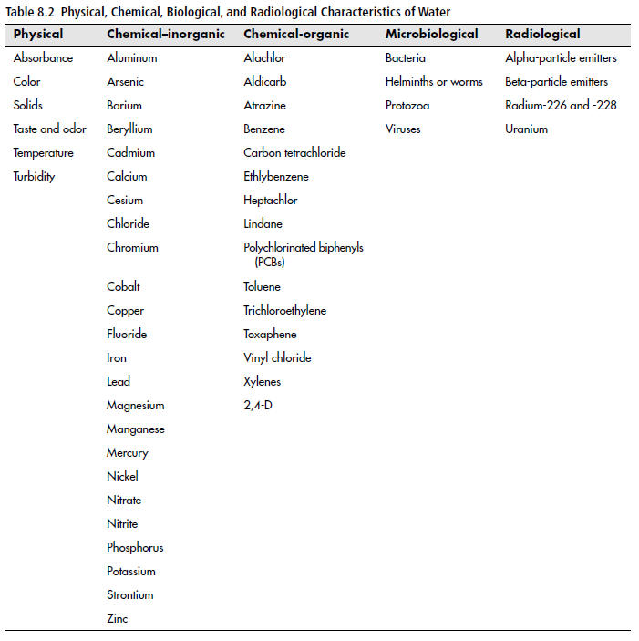
Part 10: Water Quality and Pollution

Slide 18
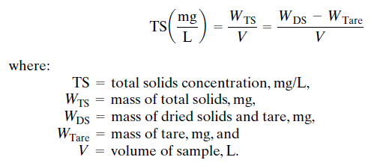
Part 10: Water Quality and Pollution
Water Quality Parameters
Turbidity – measure of water clarity
Clay, silt, finely divided organic and inorganic matter, plankton, and microorganisms cause turbidity
Solids – consist of suspended and dissolved solids, total solids (TS)

Slide 19
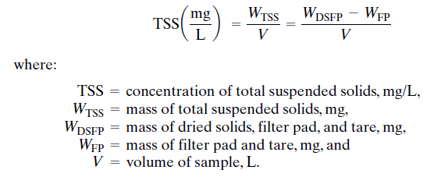
Part 10: Water Quality and Pollution
Water Quality Parameters
Total suspended solids (TSS) – portion of the total solids that can physically be removed with a filter with a specific pore size opening.

Slide 20
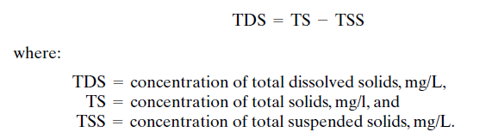
Part 10: Water Quality and Pollution
Water Quality Parameters
Total dissolved solids (TDS) concentration

Slide 21
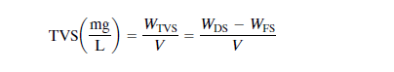
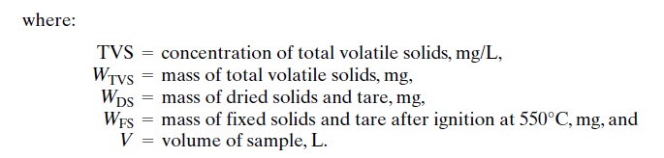
Part 10: Water Quality and Pollution
Water Quality Parameters
Each solid has a volatile fraction (organic content) and a fixed fraction (mineral content).
Total Volatile Solids (TVS) concentration

Slide 22
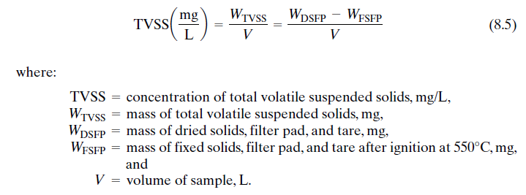
Part 10: Water Quality and Pollution
Water Quality Parameters
Total Volatile Suspended Solids (TVSS) concentration

Slide 23

Part 10: Water Quality and Pollution
Water Quality Parameters
Total fixed solids (TFS) concentration

Slide 24
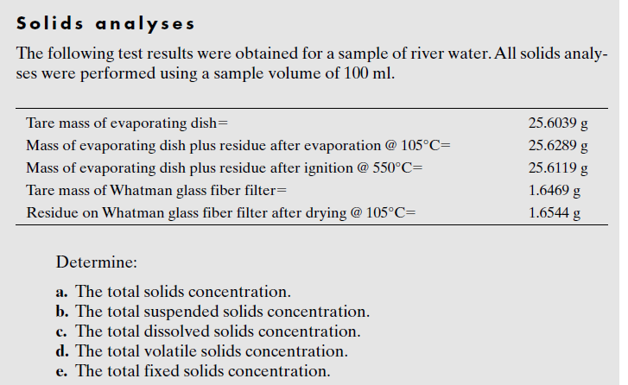
Part 10: Water Quality and Pollution
Example:

Slide 25
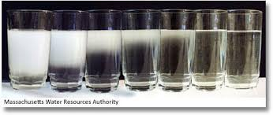
Part 10: Water Quality and Pollution
Water Quality Parameters
Color – true color is due to colloidal and dissolved substances
Decomposition of leaves
Wood byproducts – tannins, humic acid, fulvic acid, humates
Apparent color – due to suspended materials in the water

Slide 26
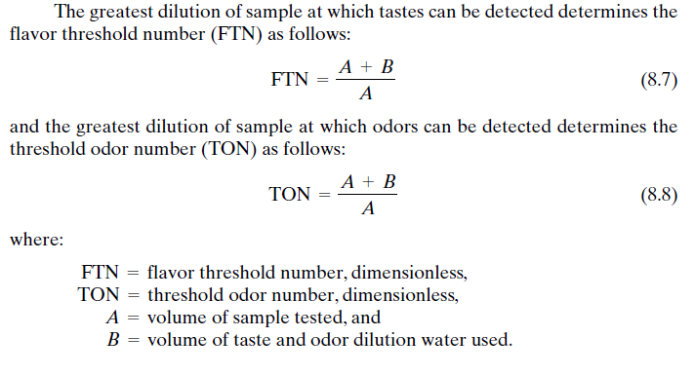
Part 10: Water Quality and Pollution
Water Quality Parameters
Taste and odor
Mainly attributed to algae
Chlorine
Hydrogen sulfide

Slide 27
ENGR 1111 Intro to Engineering: Civil Engineering Fall 2022 Part 10: Water Quality and Pollution

